Slide 1
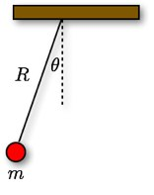
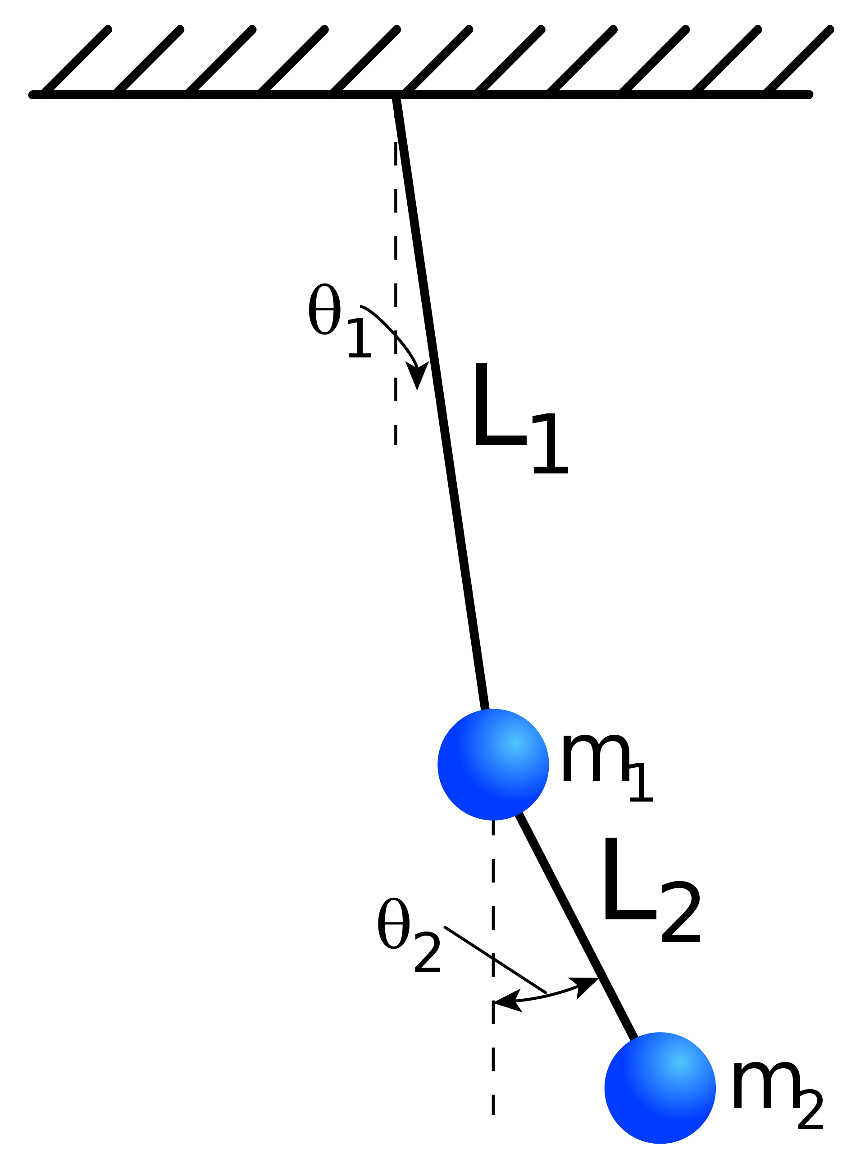
Background
Fig. 1 this picture shows a simple pendulum and all its parameters
Simple pendulums
Consistent timing and spacing forever
One of the simplest dynamic systems (see Fig. 1)
Double Pendulum
Pendulum attached to the bob of another pendulum (see Fig. 2)
Two double pendulum starting at approximately the same position can diverge
Fig. 2
This picture shows all the parameters that can be changed in a double pendulum

Slide 2
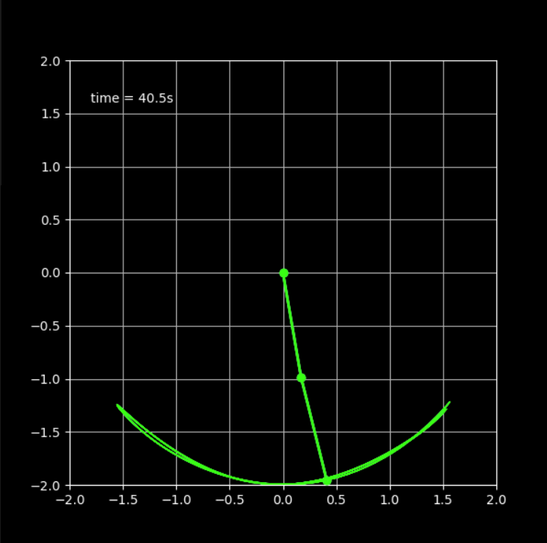
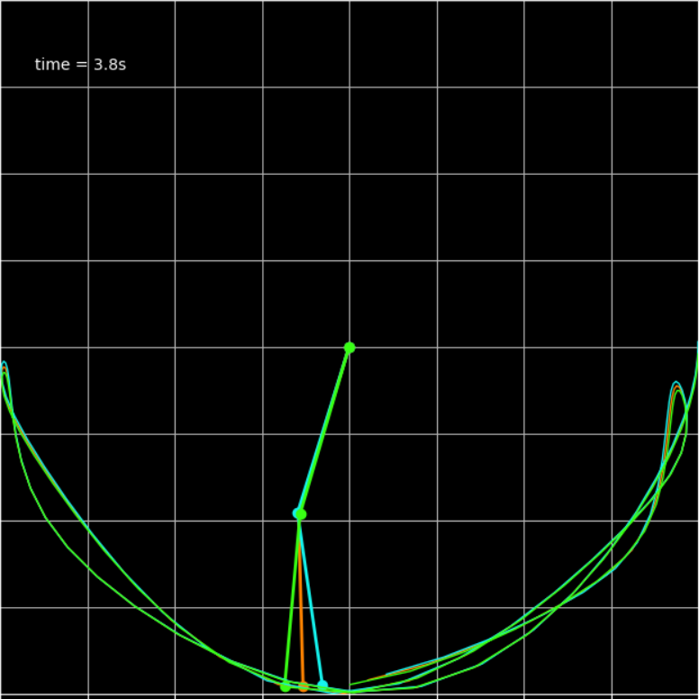
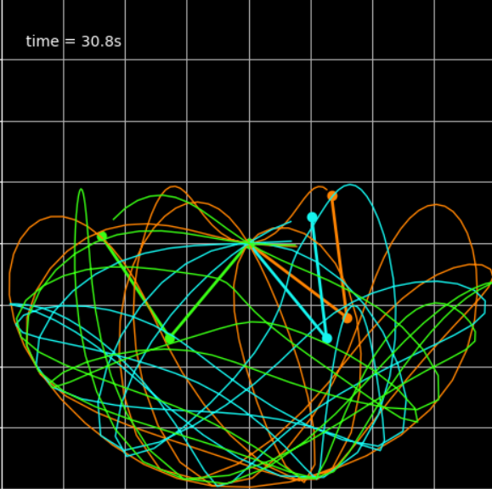
Background & Research
There are three double pendulum overlapped over one another
θ₁=50°
θ₁=90°
θ₂=90°
θ₁=90°
θ₂=50°
θ₂=90°
When the initial angles are small (e.g. 20°, three double pendulum started at 1° degree apart (Δθ= 1°) do not diverge.
They swing like simple pendulums
When the initial angles are large enough e.g. at 90°, the three double pendulum start to diverge at 3 s.
After 30s, three double pendulum diverged completely and swing in three different path. Looks like complete chaos!
This is effect is know as “Butterfly Effect”: A butterfly fluttering its wings leads to a Hurricane in later time.
This type of systems are call chaotic system and governed by nonlinear dynamics

Slide 3
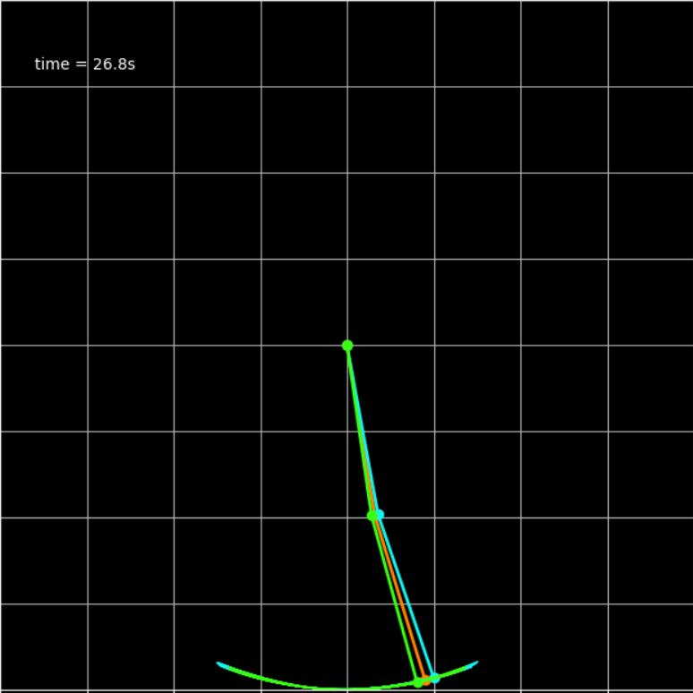
Background & Research
Weather is a chaotic system. Tiny little change in pressure temperature can later lead to a hurricane or tornado.
Double pendulum is the simplest chaotic system.
Understanding of this could some days lead to the way to predict the weather more accurately,
Question
This figure shows a double pendulum with a Δθ of 1°
What conditions are required for the motion of double pendulum to be chaotic.
How big must the difference in initial angles be in order to affect the system?
This value is Δθ
How do initial conditions affect the system?
Initial angles θ₁ and θ₂
How do mass and length affect the system
Mass
Length

Slide 4
Hypothesis and Variables
Hypothesis
Variables
I predict that
no matter how small the Δθ is, there will be chaos,
the motion of double pendulum will be normal when initial angles (θ₁ & θ₂) are small and will become chaotic at larger angles,
mass and length will not have any effect on the system.
Constants
Any unchanged independent variables
Coding environment
Hardware (Out-of-the-box HP Pavilion Laptop 15-cs1xxx)
Software (Windows 10, Python 3 NumPy, Matplotlib, SciPy)
Independent
Initial Angles (θ₁, θ₂)
Mass
Length
Variation factor(Δθ)
Dependent
Splitting time (T_{split})
Critical angle

Slide 5
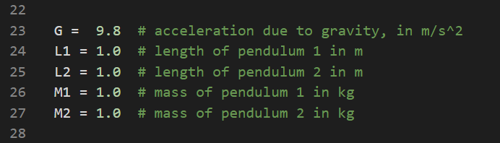
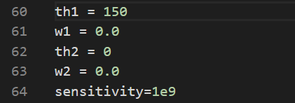
Materials
A PC, Mac or Linux system
Code
Found at https://github.com/Tharthar2/sci-fair-2020-final
Editor and Packages
Specified at GitHub in README.md
Any editor will work (including Windows Notepad) however, Spyder is recommended if you don’t know how to install packages from PyPi
Processor 1.6 GHz or faster w/ 2+ cores
4 GB+ RAM
4 GB+ disk
X64 X86 architecture
Internet access
More info at link
Code based off https://matplotlib.org/examples/animation/double_pendulum_animated.html and https://scipython.com/blog/the-double-pendulum/
Location of mass and length values
Location of angle and sensitivity values

Slide 6
Procedure: Software Installation Important! Procedure for windows 10 all experiments assume this software is in use
Install editor and packages
For Spyder https://www.anaconda.com/distribution/
Select your operating system and download for Python 3.x
When done run the .exe file
Say yes and use recommended settings
If using another python editor install the latest python 3 from https://bit.ly/37tI7kF (Windows 10) or https://bit.ly/2TYGDeb (other systems) and run “pip install NumPy, matplotlib, SciPy” in your terminal
Clone or download code from https://github.com/Tharthar2/sci-fair-2020-final
In git bash enter “cd [download directory]” and then “git clone https://github.com/Tharthar2/sci-fair-2020-final.git”
Test the code
Open Spyder
Hit Ctrl + O and find the file
Go to top bar hover over “Run” and hit “Profile” in the dropdown
If a window opens and runs the simulation, you did it. If not, consult GitHub issues tab for code or package documentation for packages and editor.

Slide 7
Procedure
Procedure: Changes in Theta
Procedure: Critical Angle Pairs
Find variable “sensitivity”. It is set to 1e1 on GitHub.
Set M1,L1,L2,M2=1 th2=th1 and th1 =90
Record how long it takes for the pendulums to diverge.
Repeat for sensitivity = 1e2, 1e3, 1e4, etc.
Eventually, the pendulums will no longer diverge. At this point, the experiment is over.
It is important to know that the last number represents the limit of your hardware, not the actual theoretical limit.
Set Mass and length values to 1.
Set th2 = th1 and th1 = 90
Adjust th1 until system becomes chaotic.
It is recommended that binary search is used; try 90 if it’s still chaotic, set to half-way between 90 and 0. If it wasn’t chaotic set to half-way between 90 and 180. do this until the borderline between chaotic and non-chaotic is found.
Repeat steps 1-3 for th2 = 0, 30, 60, 90, etc.
Repeat procedure fixing th1 instead of th2
When th1 and th2 pairs are plotted, the curve represents the border between chaotic and normal.
Any pair of points on and outside of the curve are chaotic while points inside are normal motion.

Slide 8
Procedure (cont.)
Mass
Length
Set all parameters to 1
Find the critical angle of the system
Set th1 and th2 to 90 record when the system splits into 2
Repeat for all angle ratios with numbers 1-3 e.g. m1=1,m2=2; m1=2, m 2=3; etc.
Set all parameters to 1
Adjust length the same way mass was adjusted.
Test length for critical angle
Test length for division time

Slide 9
Results: Angle variation
This graph plots when the pendulum diverges against the variation factor. The variation factor is defined on line 64 of the code and its usage is to define the difference between the 3 pendulums. The value that the pendulums differ by (Δθ) is 1/sensitivity.
The data shows that the divergence time increase with the decrease of Δθ (or increase of sensitivity) until Δθ reach 1e-7 degree. After that point the divergence time remain approximately constant around 20s until Δθ reach 1e-17. After that the double pendulums use the program doesn’t consider the angle a significant number anymore.
1.2
1.3
1.1
Note: the scale is logarithmic. This was done to illustrate the data better. A linear scale would result in most of the data being on one side.

Slide 10
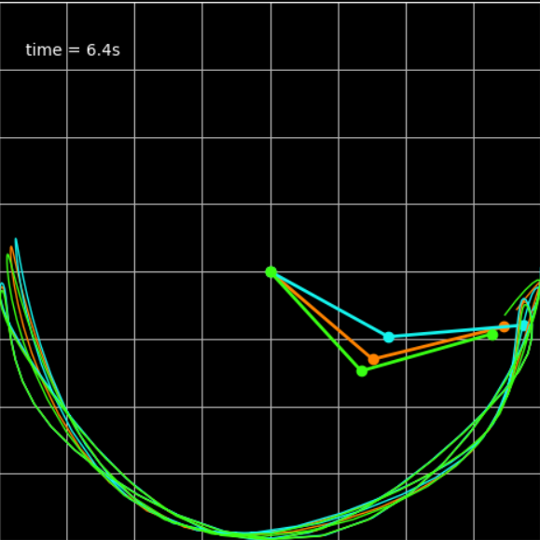
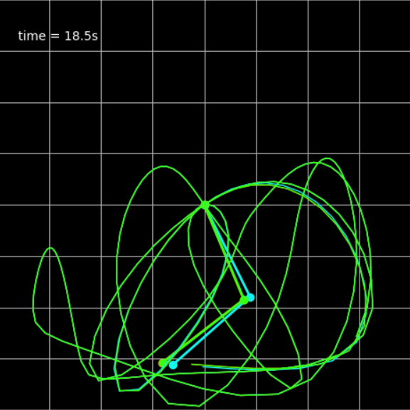
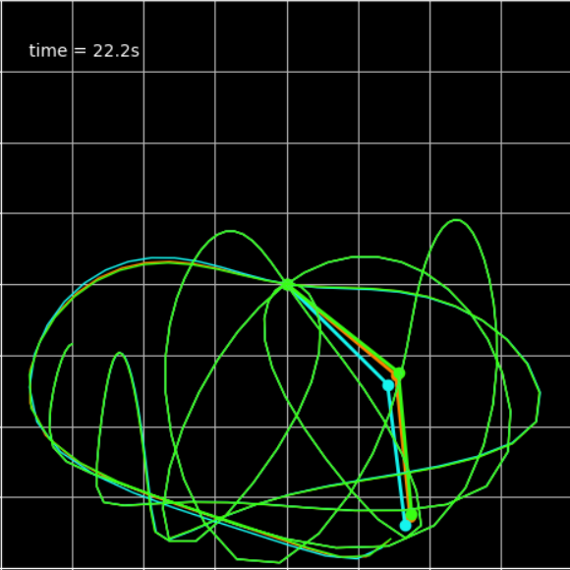
Results: Angle variation
Fig. 1.1
Δθ =1e-2
diverges at 6 sec
Fig 1.2
Δθ = 1e-7
diverges at 18 sec
Fig 1.3
Δθ = 1e-15
diverges at 22 sec

Slide 11
Initial Angle Pairs: Border between chaotic and normal system
*
This is the chart of angle combinations that yield chaotic results.
A double pendulum starting at any pair of initial angles (θ₁ and θ₂) inside the red region will be a predictable system.
Any pair of θ₁ and θ₂ in the green region will show chaotic motion.
Fig. 2.3
120&0
Chaotic
Fig. 2.2
80.01&0
.
Fig. 2.1
50&0
Predictable

Slide 12
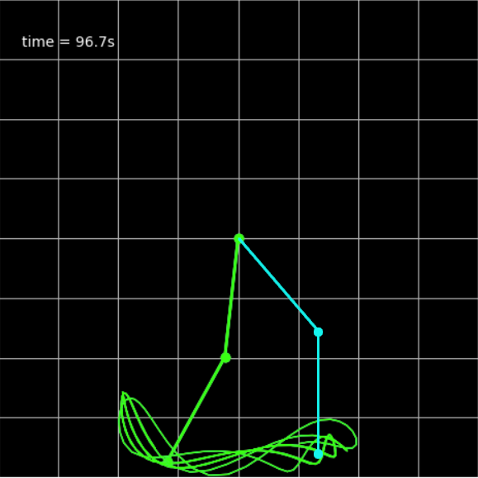
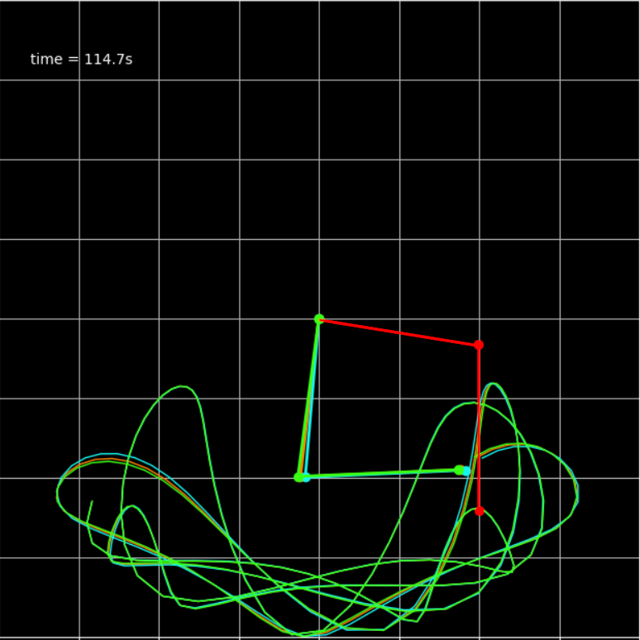
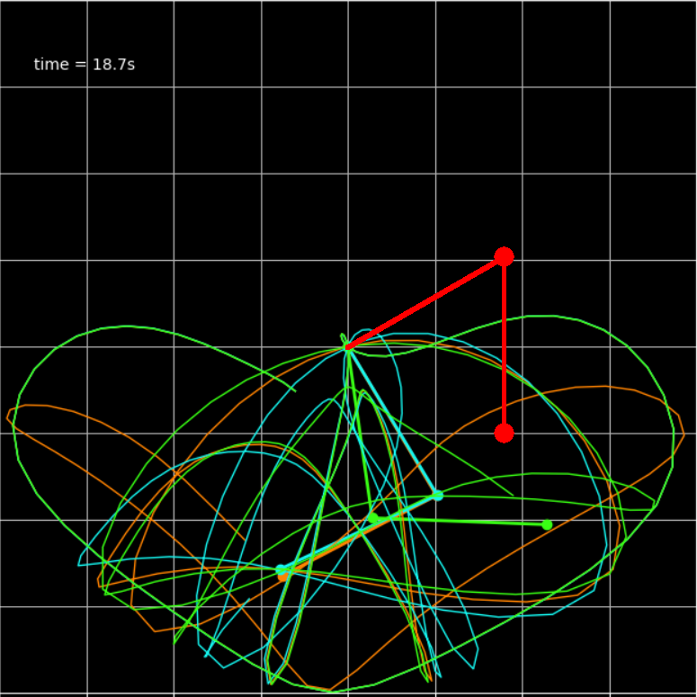
Initial Angle Pairs: Border between chaotic and normal system
Fig. 2.1
θ₁ =50°, θ₂= 0°
T_{split}= 96 sec
Blue=initial
Fig. 2.2
θ₁ =80.01, θ₂= 0
T_{split}= 114 sec
Red=initial
Fig. 2.3
θ₁= 120, θ₂= 0
T_{split}= 18 sec
Red=initial

Slide 13
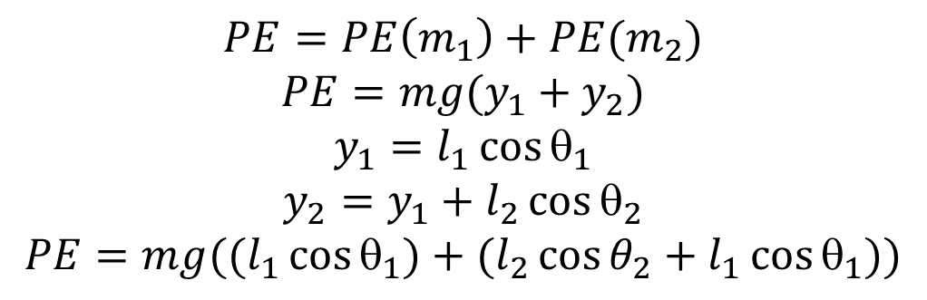
Does Potential Energy Control Chaos?
The potential energy of all angle pairs in the previous experiment was computed and plotted against the splitting time. The data shows that there is no correlation between potential energy and divergence time.
$$PE=PE\left(m_{1}\right)+PE(m_{2})$$
$$PE=mg(y_{1}+y_{2})$$
$$y_{1}=l_{1}\cos{θ_{1}}$$
$$y_{2}=y_{1}+l_{2}\cos{θ_{2}}$$
$$PE=mg((l_{1}\cos{θ_{1})+(l_{2}\cos{θ_{2}+l_{1}{\cos{θ}}_{1}))}}$$

Slide 14
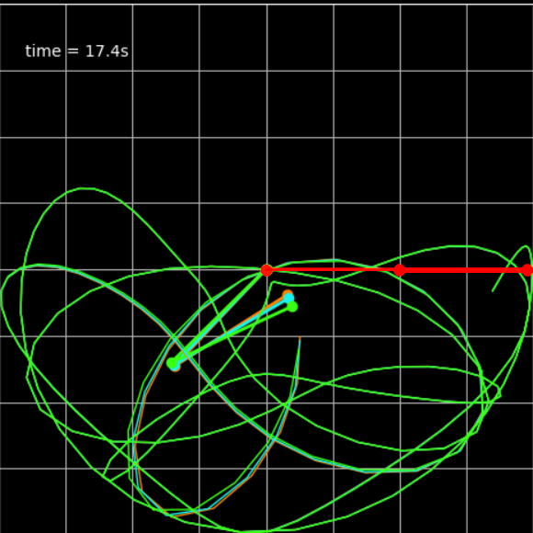
Double pendulum with two different Masses
This chart shows that there is no correlation between mass ratio and the critical angle. The data still showed no correlation even after averaging with 4 other trials.
Set θ₁= θ₂
Find the critical angle for different values of mass ratio.
Critical angle: the smallest angle that show chaotic motion.
This chart shows the effect of mass difference on the critical angle. The graph is a mirrored mirror image of one side.

Slide 15
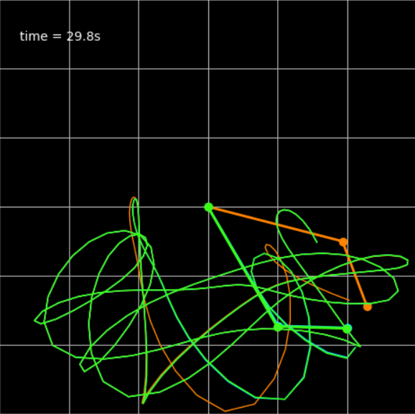
Double pendulum with two different Lengths
When length is varied, the critical angle goes down in steps of 3 data points getting more spread out as the length ratio increases.
This shows the mass difference plotted against the critical angle. Is shows a similar mirroring pattern to mass.
.
Both patterns in length demand further investigation

Slide 16
Conclusion
Speaking on the difference in initial angle (Δθ), I was incorrect in practice.
On the initial angle pairs, I was correct.
When it came to the mass and length, I was incorrect.
Certain pairs lead to chaotic motion while other give normal motion.
In addition I also discovered that
There is a sharp borderline between chaotic and normal motion
The borderline show complex shape
Δθ as small as 1E-16 can lead to butterfly effect.
In theory, no matter how small, it should diverge
Butterfly effect disappears for Δθ < 1E-17
But this is the limit of 64 bit Windows computer
Mass and length had very interesting correlations with the critical angle.

Slide 17
Citations
“Animation Example Code: double_pendulum_animated.Py¶.” Animation Example Code: double_pendulum_animated.Py - Matplotlib 2.0.2 Documentation, 2018, matplotlib.org/examples/animation/double_pendulum_animated.html.
Asylum, The Science. “Lagrangian Mechanics: How Powerful Is It?” YouTube, YouTube, 9 July 2019, https://www.youtube.com/watch?v=MIBfKJHMWHU
Britannica, The Editors of Encyclopaedia. “Chaos Theory.” Encyclopædia Britannica, Encyclopædia Britannica, Inc., 2 Apr. 2019, www.britannica.com/science/chaos-theory#ref251589.
“The Double Pendulum.” The Double Pendulum, 2019, scipython.com/blog/the-double-pendulum/.

